Slide 1


FOUNDING PARTNER OVERVIEW · INVITATION ONLY
SOHE 2027
The inaugural gathering of higher education's most consequential leaders.
LATE JULY 2027 · CITY TO BE ANNOUNCED · INSTITUTIONAL + INDUSTRY LEADERS · CREATED & LED BY JEFF SELINGO

Slide 2

THE MOMENT
Higher education faces an unprecedented moment.
Leaders need to act. Every choice is a tradeoff.
The challenges are interconnected. More of them are now enterprise risks. Demographic shifts and doubts about value are reshaping who enrolls. Academic standing shapes conference membership, which shapes revenue. New AI investments compete with the dollars needed for buildings and talent. Moves on athletics, research, federal policy, and governance ripple into every corner of the budget.
Yet presidents, boards, and cabinets still work these problems one at a time: one conference, one report, one consultant. That no longer matches the moment. What's missing is a room where the sector's most consequential leaders work the whole picture together.
02

Slide 3
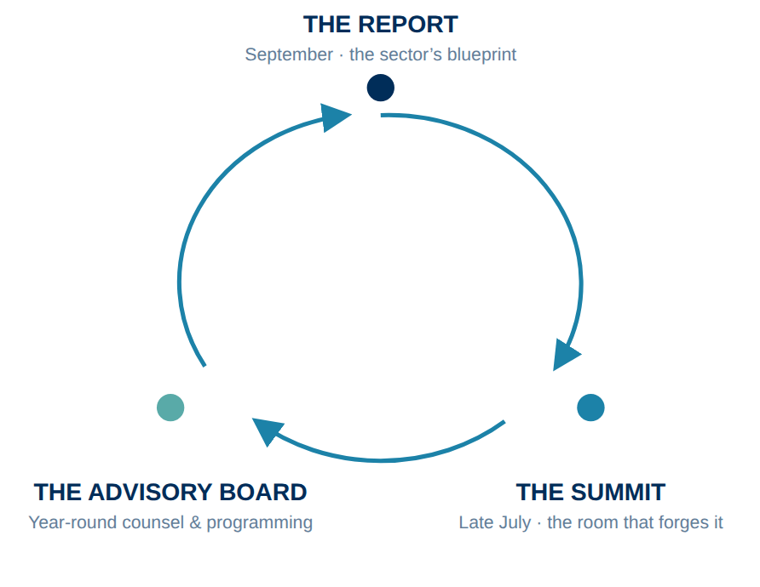
A YEAR-ROUND ECOSYSTEM
From an annual report to a strategic ecosystem.
To meet this moment, Jeff Selingo’s State of Higher Education (SOHE) is expanding from a single annual report into a permanent, year-round strategic ecosystem, anchored by the inaugural, live, and in-person SOHE ’27.
Far from a traditional conference, SOHE ’27 is an invitation-only working group for the leaders who carry ultimate operational responsibility. By bringing peers together, it creates a direct feedback loop: the insights shared in the room explicitly forge the next edition of the report: an actionable blueprint for an industry under pressure.
03

Slide 4
THE SOHE ’27 EXPERIENCE
Twenty-four hours. Consequential leaders.
An immersive, lunch-to-lunch experience combining the caliber of an exclusive executive retreat with the execution focus of an elite working group: structured so a C-suite leader can arrive in the morning and be home the next evening.
DAY ONE · MIDDAY
DAY ONE · AFTERNOON
DAY ONE · EVENING
DAY TWO · MORNING
The opening table
The working sessions
The salon evening
The blueprint
The convening begins over a working lunch: the state of the sector, framed by Jeff Selingo, and the questions the room is there to answer.
Structured conversations and private working groups across six interconnected themes, plus an optional site visit to a nearby innovation setting.
Off-the-record salon dinners and receptions built for candid peer conversation, hosted with Founding Partners.
The room consolidates what it learned; a closing lunch sets the agenda that shapes the SOHE 2027 report.
INVITATION ONLY
PRESIDENTS, TRUSTEES, C-SUITE & INDUSTRY LEADERS
LATE JULY 2027
CITY TO BE ANNOUNCED
04

Slide 5

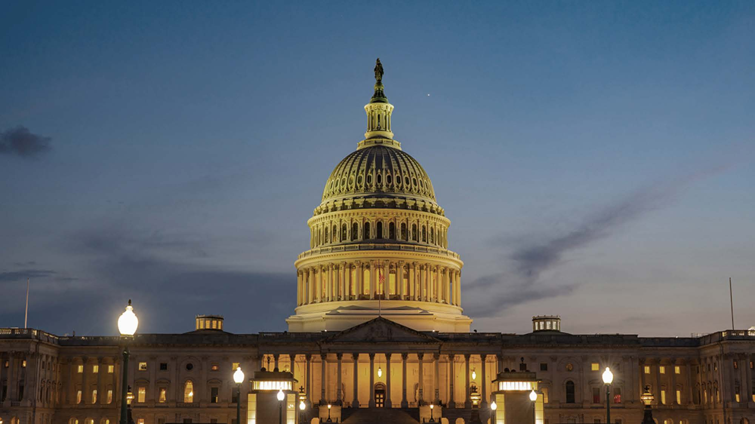

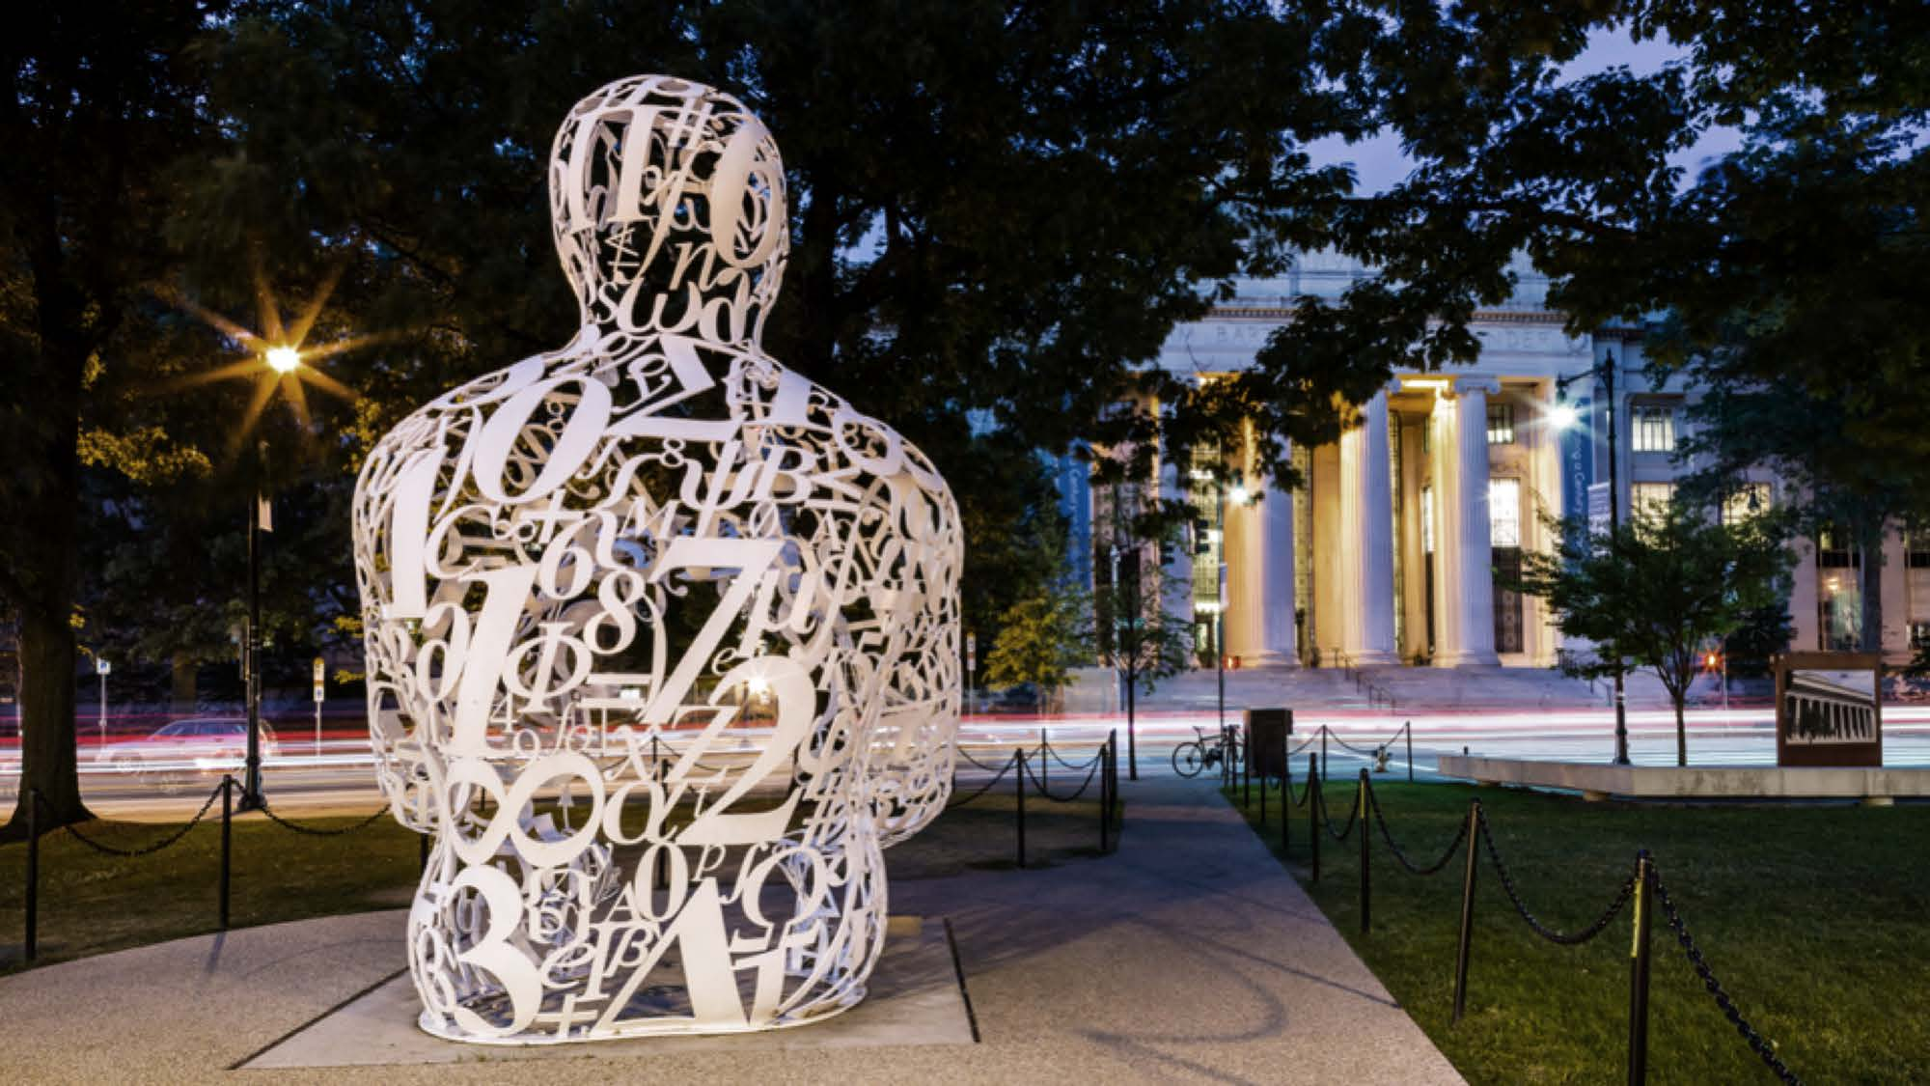


SIX INTERCONNECTED THEMES
Organized around the sector’s six hardest questions.
01
02
03
THE BUSINESS MODEL
WASHINGTON
RESEARCH
Deciding where institutions must concentrate increasingly scarce resources.
Planning institutional continuity amid unprecedented federal uncertainty.
Evaluating which ambitions the sector can afford to sustain.
04
05
06
ARTIFICIAL INTELLIGENCE
ATHLETICS
GOVERNANCE
Verifying which technology investments deliver immediate, measurable value.
Quantifying what shifting sports commitments truly cost the institution.
Re-architecting how presidents and boards make harder decisions, faster, together.
Advisory board: an exclusive advisory board is being formed under Jeff Selingo’s leadership, to be announced in Q4 2026.
05

Slide 6
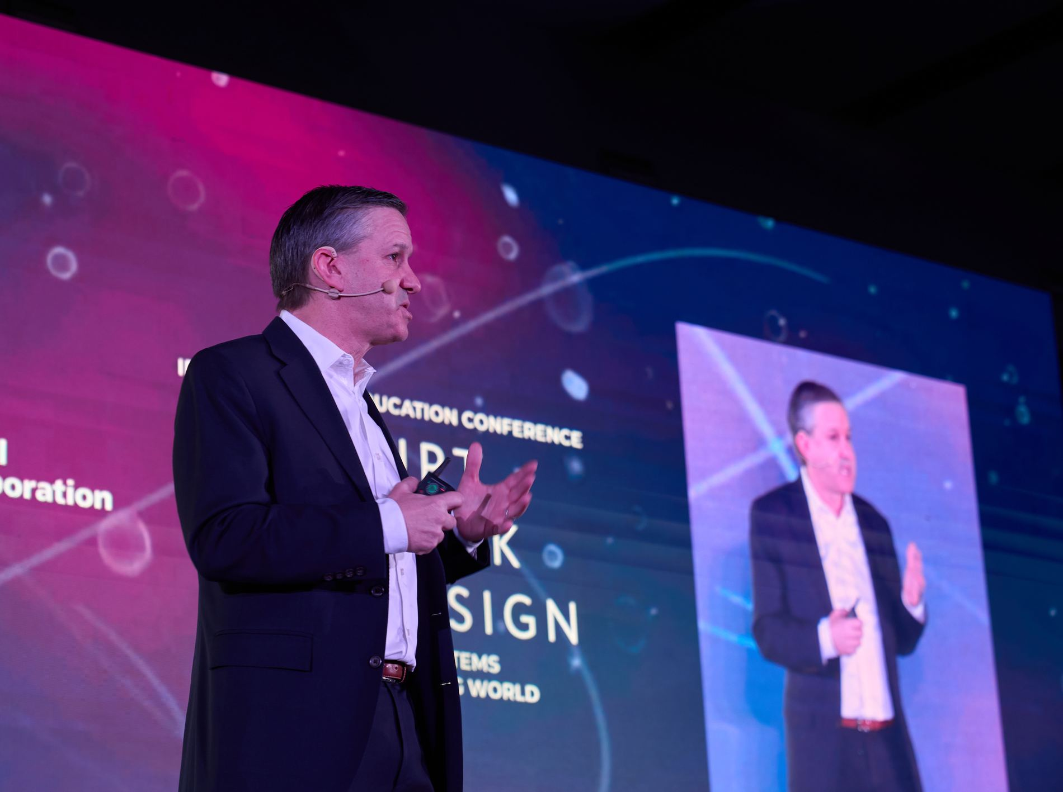
CREATED AND LED BY
JEFF SELINGO
Three-time New York Times bestselling author and the sector’s most trusted independent voice on the future of higher education. A regular contributor to The Atlantic and The New York Times, special advisor for innovation and professor of practice at Arizona State University, co-host of the Future U. podcast, and author of Next, the newsletter read across higher education’s leadership.
06

Slide 7
THE FOUNDING PARTNER OPPORTUNITY
Fully integrated into the work, not logos on the sideline.
We are curating a select group of Founding Partners ready to visibly demonstrate their commitment to solving higher education’s compounding challenges. This is not a traditional corporate sponsorship: Founding Partners integrate their top executives, operational expertise, and core messaging directly into the SOHE experience before, during, and after SOHE ’27, with an active relationship to elite institutional decision-makers throughout the year.
Founding Partner Opportunity.
Your Executives in the room
A year-round seat.
Every Founding Partner holds the same premier position, shaped to their expertise rather than a rate card.
The standard is partners the room already wants to hear from: a known voice from the sector, on stage in conversation with Jeff, never a commercial pitch.
The Summit anchors a relationship that runs through the advisory board, the report, and the programming that follows.
07

Slide 8
FOUNDING PARTNER BENEFITS
Before, during, and after SOHE ’27.
BEFORE SOHE ’27
DURING SOHE ’27
AFTER SOHE ’27
Establish your presence.
Recognition on all SOHE materials.
Showcase your expertise.
Align your company with an issue central to the SOHE agenda.
Help shape the agenda.
Nominate a qualified senior executive for the advisory board.
Shape the report.
Help pressure-test the research behind SOHE 2027.
Join the room.
Bring 2–3 executives into the invitation-only gathering.
Share your perspective.
Feature your senior executive in a fireside conversation with Jeff Selingo.
Build executive relationships.
Participate in selected private working sessions and meals.
Co-host the salon evening.
Convene attendees at a salon dinner, roundtable breakfast, or reception.
Launch the report.
Lead partner recognition in the September release of SOHE 2027.
Integrate your perspective.
Clearly identified sponsored content and relevant partner data in the report.
Bring the findings to leaders.
A leading partner role in the fall briefing or webinar.
Sustain your presence.
Ongoing visibility in SOHE content and programming throughout the year.
08

Slide 9
FOUNDING PARTNER PROPOSAL
[Partner Name]
The SOHE ’27 Founding Partner position, customized for [Partner Name]: one integrated, year-round plan across the report, SOHE ’27, and the programming that follows.
ASSET | DETAILS | TIMING | INCLUDED
BEFORE SOHE ’27 · ESTABLISH THE POSITION
Brand presence | Founding Partner recognition on all SOHE materials and communications. | From signing | ✓
Theme alignment | [Partner Name] aligned with a central SOHE theme: [theme]. | From signing | ✓
Advisory board seat | Nominate a qualified senior executive to the SOHE advisory board. | Announced Q4 2026 | ✓
Research access | Help pressure-test the research and findings behind SOHE 2027. | Spring 2027 | ✓
AT SOHE ’27 · JOIN THE ROOM
Executive seats | 2–3 [Partner Name] executives inside the invitation-only gathering. | Late July 2027 | ✓
Fireside conversation | Your senior executive on the mainstage in conversation with Jeff Selingo. | Late July 2027 | ✓
Working sessions & meals | Participation in selected private working sessions and executive meals. | Late July 2027 | ✓
Salon experience co-host | Convene attendees at a salon dinner, roundtable breakfast, or reception. | Late July 2027 | ✓
AFTER SOHE ’27 · CARRY THE WORK FORWARD
Report launch | Lead partner recognition in the September release of SOHE 2027. | September 2027 | ✓
Integrated content | Clearly identified sponsored content and relevant [Partner Name] data in the report. | September 2027 | ✓
Fall briefing / webinar | A leading partner role in the launch briefing or webinar. | Fall 2027 | ✓
Year-round visibility | Ongoing presence in SOHE content and programming throughout the year. | Through mid-2028 | ✓
ANNUAL FOUNDING PARTNER INVESTMENT: $ [________]
Chris Leighton · chris@jeffselingo.com · [Date]

Slide 10
SHAPE THE PATH FORWARD
CONTACT
Chris Leighton
Demonstrate what your company can contribute, build relationships with the people making higher education’s hardest decisions, and carry that work into the year ahead. Founding Partner positions are limited.
chris@jeffselingo.com
to discuss and customize
your founding partnership
09

