Slide 1


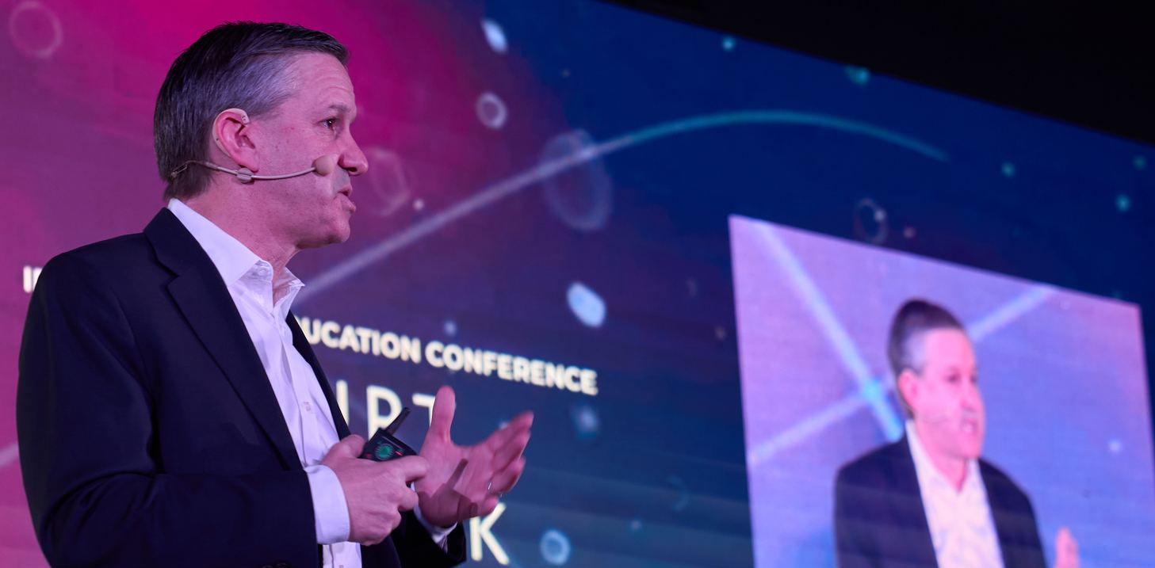
FOUNDING PARTNER OVERVIEW
SOHE 2027
The inaugural gathering of higher education's most consequential leaders.
LATE JULY 2027 · CITY TO BE ANNOUNCED · INSTITUTIONAL + INDUSTRY LEADERS · CREATED & LED BY JEFF SELINGO
Higher education faces an unprecedented moment. Leaders need to act. Every choice is a tradeoff.
The challenges are interconnected. More of them are now enterprise risks. Demographic shifts and doubts about value are reshaping who enrolls. Academic standing shapes conference membership, which shapes revenue. New AI investments compete with the dollars needed for buildings and talent. Moves on athletics, research, federal policy, and governance ripple into every corner of the budget.
Yet presidents, boards, and cabinets still work these problems one at a time: one conference, one report, one consultant. That no longer matches the moment. What’s missing is a room where the sector’s most consequential leaders work the whole picture together.
To meet this moment, Jeff Selingo’s State of Higher Education (SOHE) is expanding from a single annual report into a permanent, year-round strategic ecosystem, anchored by the inaugural, live, and in-person SOHE ’27: an invitation-only working group for the leaders who carry ultimate operational responsibility, whose insights explicitly forge the next edition of the report.
A select group of Founding Partners will help build this experience, bringing their executives, expertise, and message into the conversation before, during, and after SOHE ’27 while demonstrating their commitment to higher education’s future.
CREATED AND LED BY
JEFF SELINGO
Three-time New York Times bestselling author, co-host of the Future U. podcast, and the sector’s most trusted independent voice on the future of higher education.

Slide 2

THE SOHE ’27 EXPERIENCE
Twenty-four hours. Consequential leaders. Six themes.
An immersive, lunch-to-lunch experience combining the caliber of an exclusive executive retreat with the execution focus of an elite working group: structured conversations, private working sessions, and off-the-record executive meals, organized around six interconnected strategic themes.
01
THE BUSINESS MODEL
Deciding where institutions must concentrate increasingly scarce resources.
02
WASHINGTON
Planning institutional continuity amid unprecedented federal uncertainty.
03
RESEARCH
Evaluating which ambitions the sector can afford to sustain.
04
ARTIFICIAL INTELLIGENCE
Verifying which technology investments deliver immediate, measurable value.
05
ATHLETICS
Quantifying what shifting sports commitments truly cost the institution.
06
GOVERNANCE
Re-architecting how presidents and boards make harder decisions, faster, together.
Advisory board: an exclusive advisory board is being formed under Jeff Selingo’s leadership, to be announced in Q4 2026.
FOUNDING PARTNER OPPORTUNITY
Fully integrated into the work, not logos on the sideline.
We are curating a select group of Founding Partners ready to visibly demonstrate their commitment to solving higher education’s compounding challenges. This is not a traditional corporate sponsorship: Founding Partners integrate their top executives, operational expertise, and core messaging directly into the SOHE experience before, during, and after SOHE ’27, with an active relationship to elite institutional decision-makers throughout the year.
BEFORE SOHE ’27
DURING SOHE ’27
AFTER SOHE ’27
Establish your presence.
Recognition on all SOHE materials.
Showcase your expertise.
Align your company with an issue central to the SOHE agenda.
Help shape the agenda.
Nominate a qualified senior executive for the advisory board.
Shape the report.
Help pressure-test the research behind SOHE 2027.
Join the room.
Bring 2–3 executives into the invitation-only gathering.
Share your perspective.
Feature your senior executive in a fireside conversation with Jeff Selingo.
Build executive relationships.
Participate in selected private working sessions and meals.
Launch the report.
Lead partner recognition in the September release of SOHE 2027.
Integrate your perspective.
Clearly identified sponsored content and relevant partner data in the report.
Bring the findings to leaders.
A leading partner role in the fall briefing or webinar.
Sustain your presence.
Ongoing visibility in SOHE content and programming throughout the year.
SHAPE THE PATH
FORWARD
CONTACT
Chris Leighton
Demonstrate what your company can contribute, build relationships with the people making higher education’s hardest decisions, and carry that work into the year ahead. Founding Partner positions are limited.
chris@jeffselingo.com
to discuss and customize your
founding partnership

